Slide 1

MOTION BLUR
Jagat Kiran Alla,
MSc Data Analytics
Supervisor: Dr Joab Winkler

Slide 2
Contents
Motion blur introduction
Motion blur removal techniques
Our proposed method to remove blur
Observations and experiments
Conclusions

Slide 3
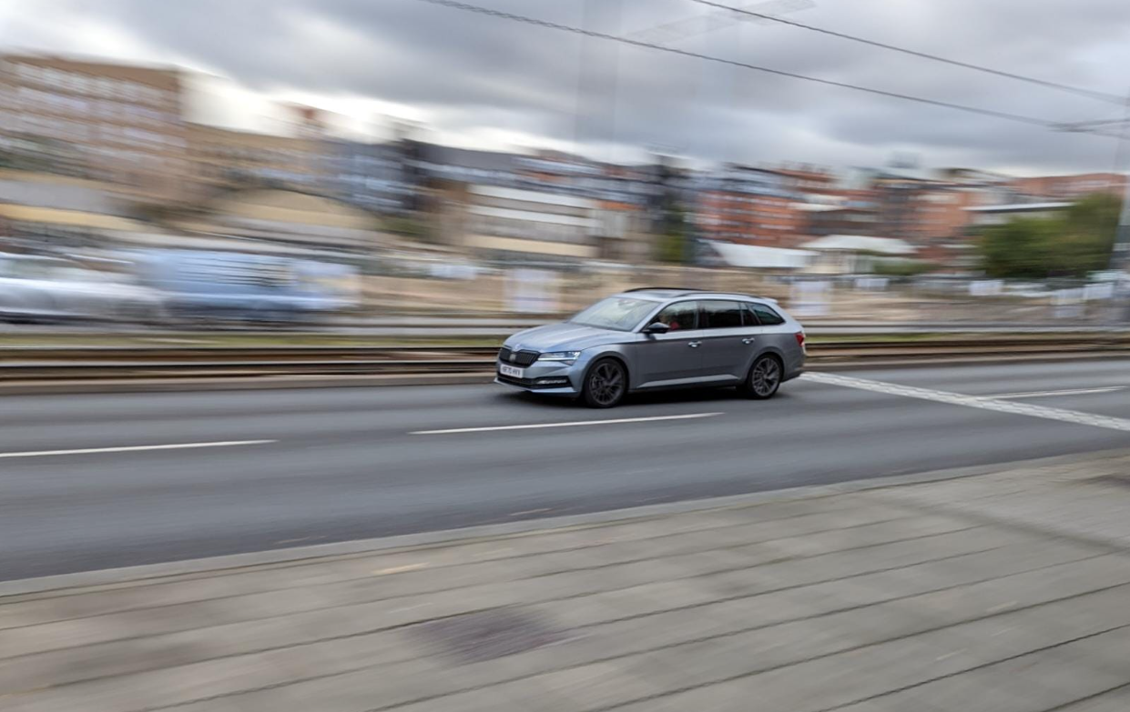
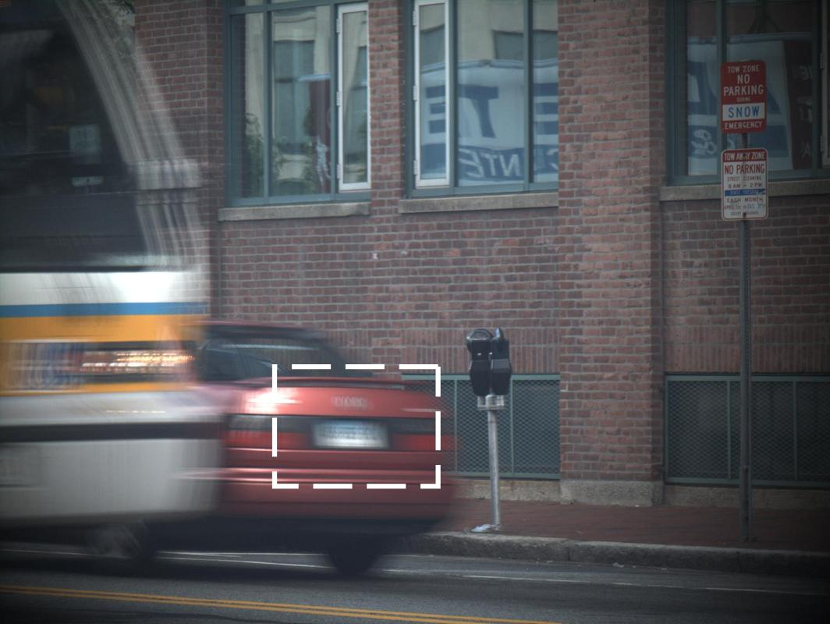
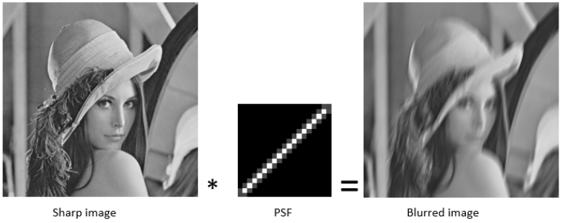
Motion Blur
Common artefact caused due to relative motion between camera and scene.
Can make images look artistic, but more often then not, motion blur is undesirable.
Research on methods to remove blur from a single blurred image.
Can be modelled as a convolution operation(*) using a PSF(Point Spread Function) or Blur Kernel.

Slide 4

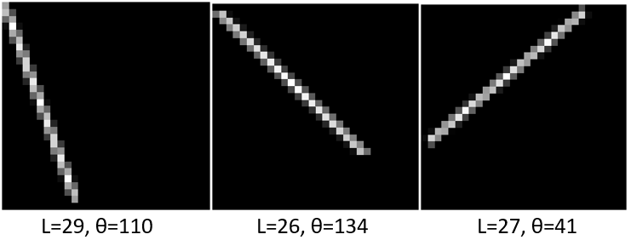

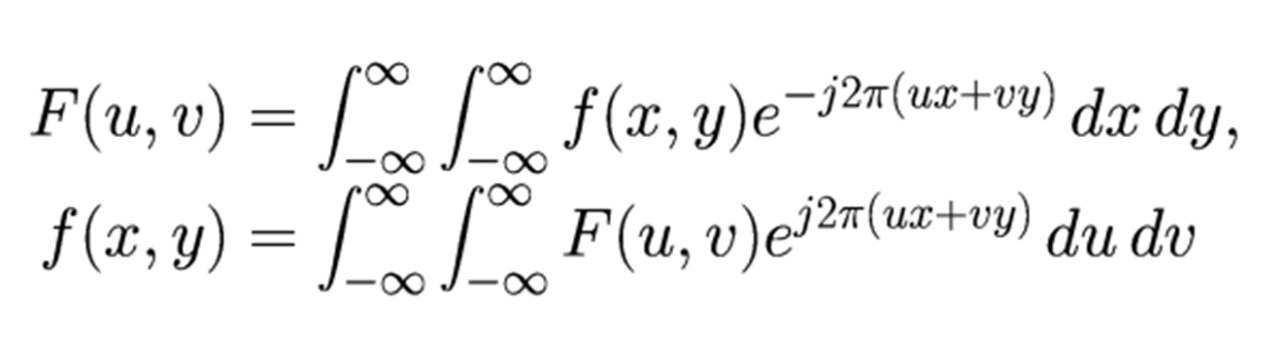
Removing Motion Blur
Convolution- get blur image. Reverse convolution/deconvolution- get sharp image.
Zero division and noise case in deconvolution like Inverse filter. Other algorithms to solve this- Lucy Richardson, Wiener filter, Regularised filter
But PSF unknown most of the times/ deconvolution problem.
Early research made prediction on PSF using prior statistical knowledge on image and kernel, but limited to use cases.
Our research- linear motion blur. Parameters Length(L) and Angle(θ).
Our method finds PSF using the 2 dimensional Fourier transformation of blurred image.

Slide 5
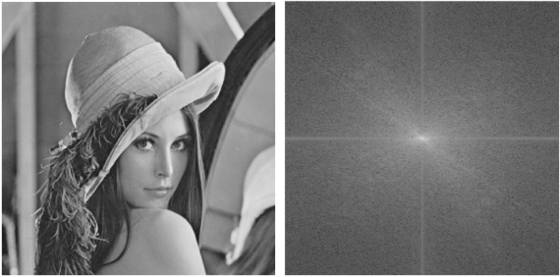
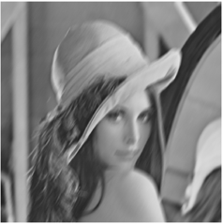
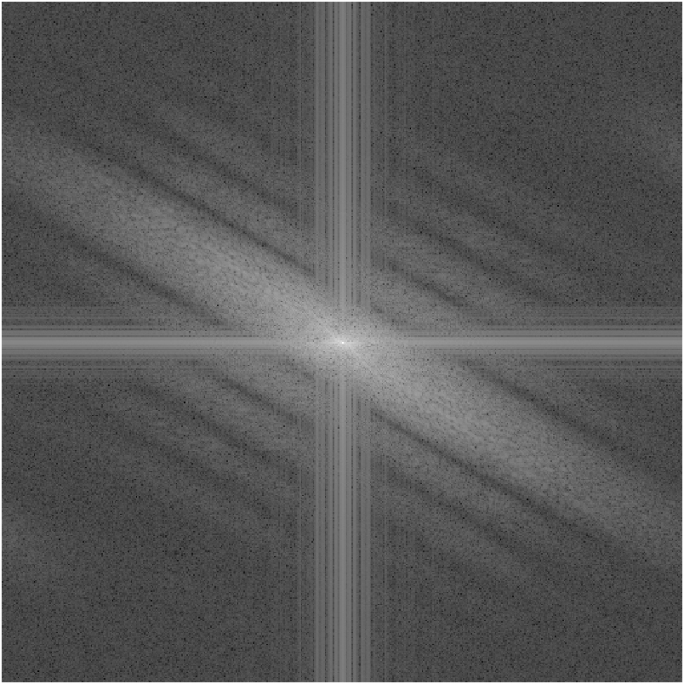
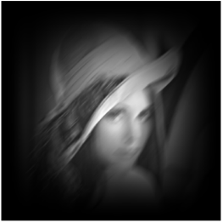
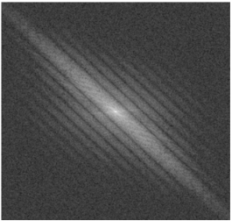
Proposed method
Log spectrum or Log Fourier transformed image of blurred image. V(x,y) is FFT of blurred image.
Log FFT of sharp image
Log FFT of blurred image
Find angle parameter from the log Fourier transform image by finding the angle bright line makes with the vertical axis after preprocessing.

Slide 6
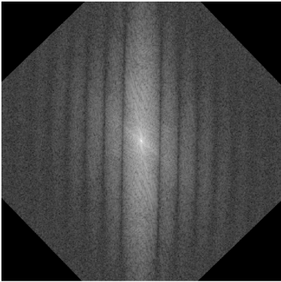
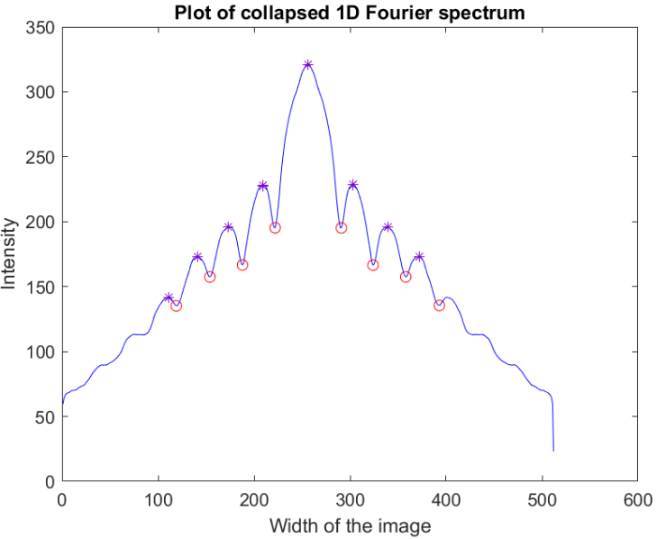
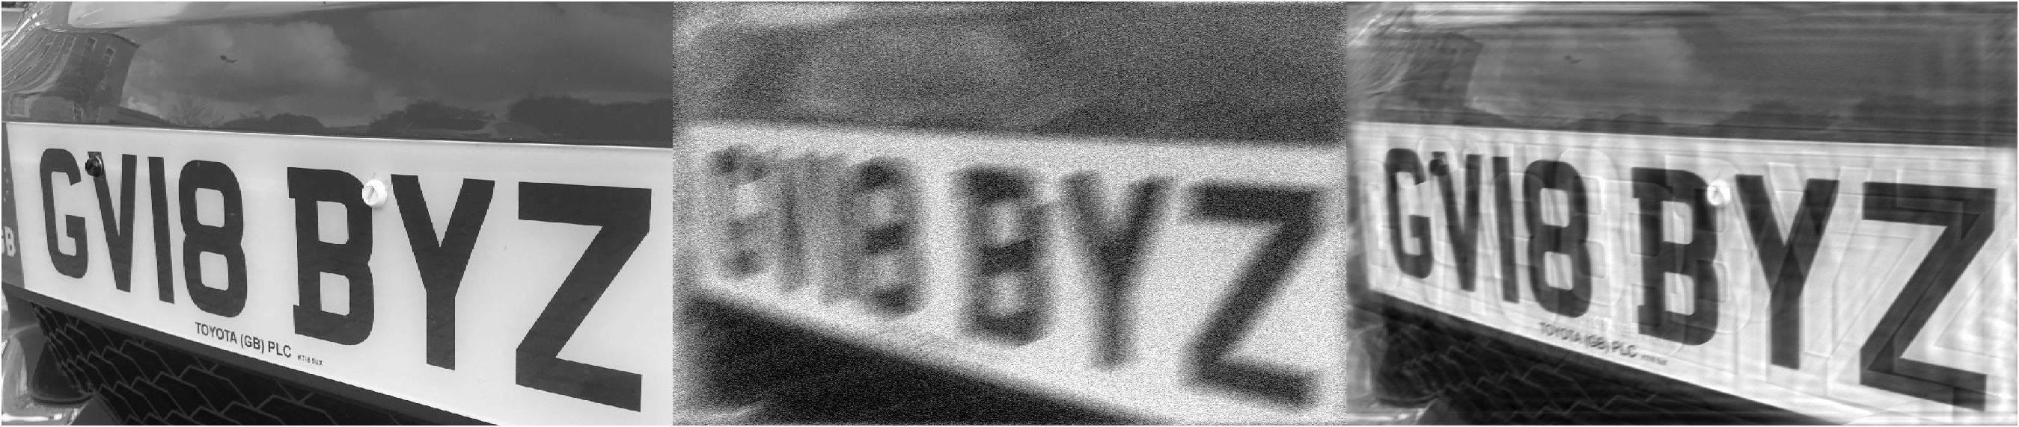
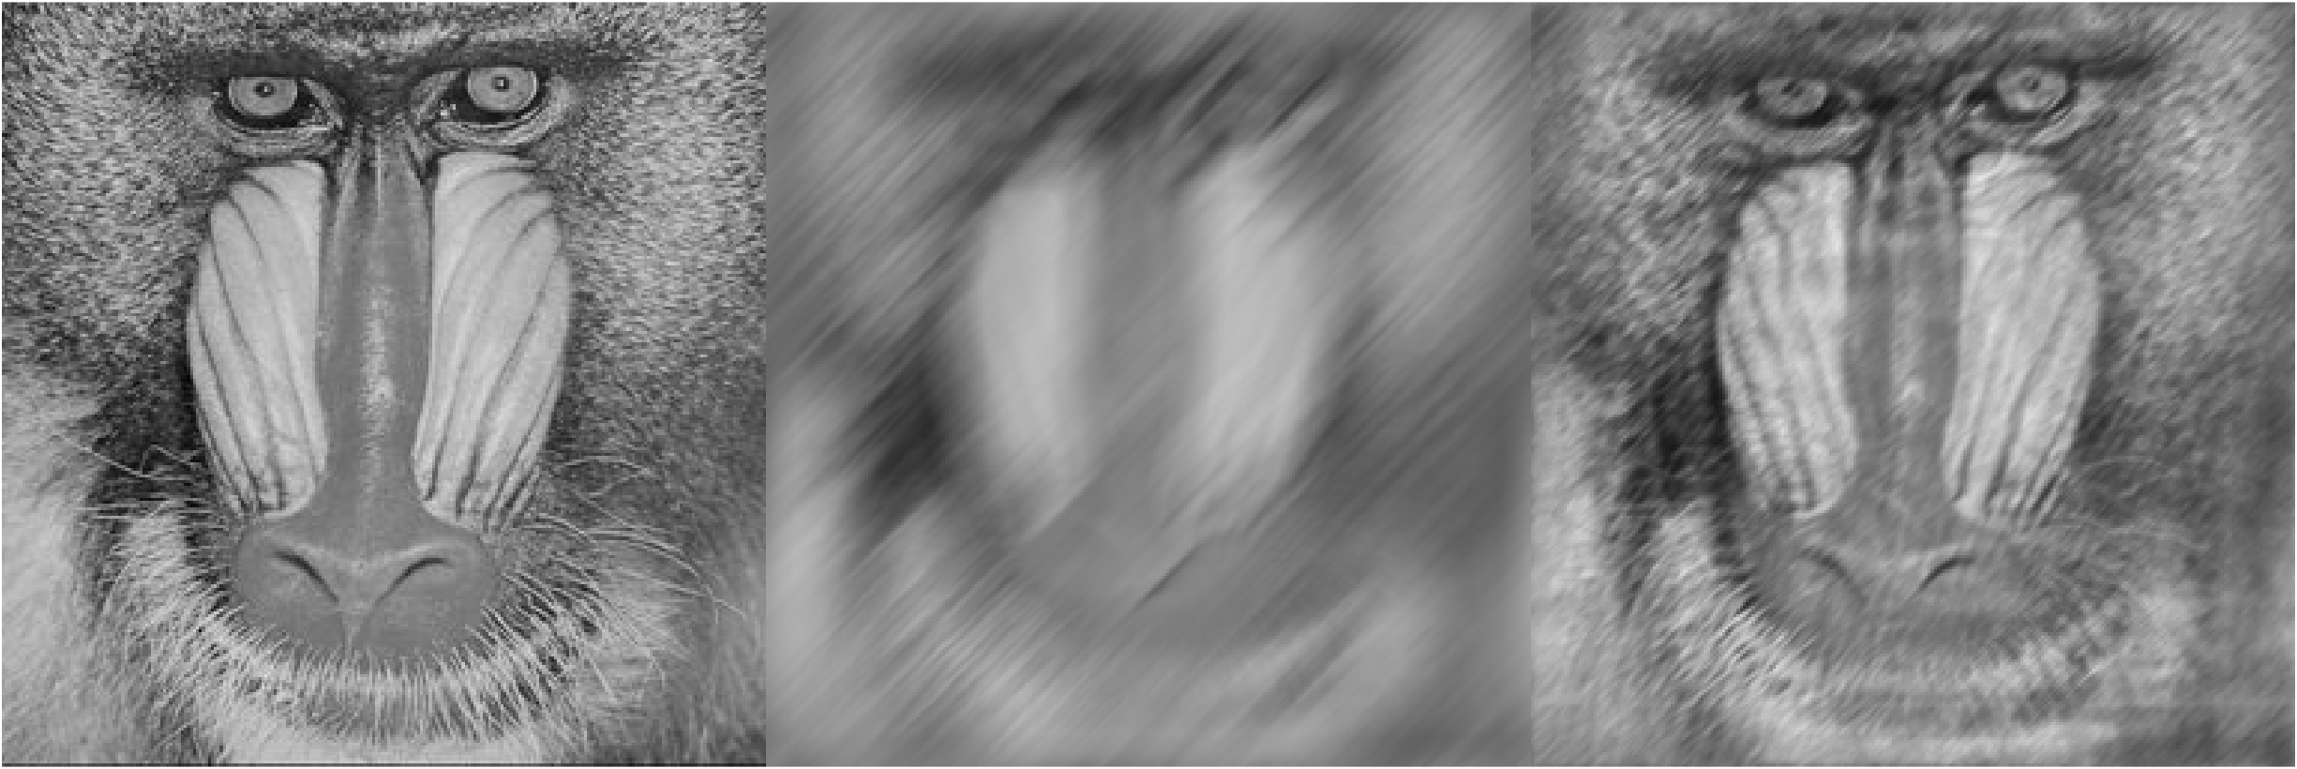
Find length parameter by inversely rotating the log Fourier image with angle found.
Construct the blur kernel using parameters found, and perform deconvolution.

Slide 7
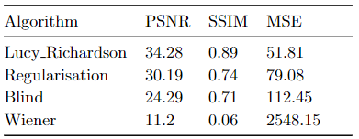
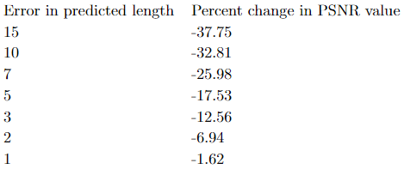
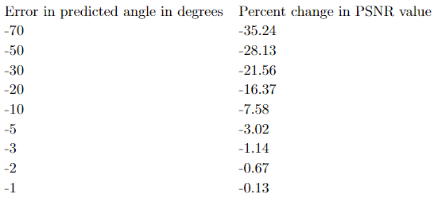
Findings and Experiments
Our method works even for low levels of blur unlike other studies based on linear motion blur.
Average error in length prediction- 0.4 units, angle prediction- 1.1°.
Additional experiments on deconvolution algorithm for motion blur case.
Effect of errors in parameters calculation.

Slide 8
Conclusion
Research ongoing on Deep Learning methods combined with traditional methods.
Linear motion blur most common and our research interest.
Our method estimates Length parameter accurately.
Lucy Richardson algorithm best for motion blur deconvolution.
Predicting exact length parameter important than predicting angle parameter for deconvolution.

